Slide 1
Solutions that make life green!

Slide 2
Solar Direct
NABCEP Certifications for Solar PV and Solar Thermal
Solar Contractors and Engineers since 1986
Solar & Mechanical Engineer on Staff
Government Approved Vendors
Experienced in commercial applications
Contractor network throughout the U.S.
Projects co-engineered for site specific solutions

Slide 3
Solar Direct Qualifications
Solar Engineering Degree
Solar Contractor License
Electrical Contractor License
Solar Water Heating Contractor License
Commercial Swimming Pool Contractor License
USGBC LEED Certified
NABCEP Certified
Building and Construction Law Certification
Building Code Certification
Code Compliance Certification
Excavation Certification
Safety Certification

Slide 4
TECHNOLOGIES: Solar Pool Heating Solar Thermal Solar Electric Heat Pump Pool Water Heating Pool Water Purification Treatment

Slide 5
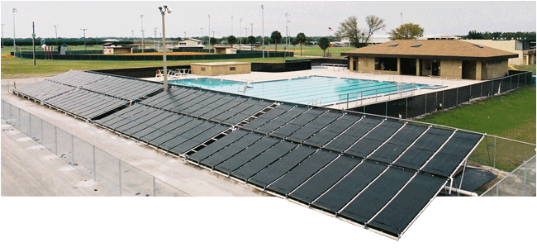
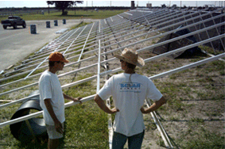
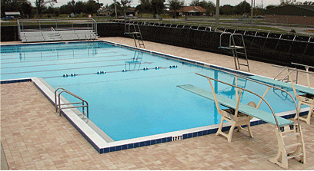
Hardee County High School
Solar Pool Heater
System Configuration
80 Vortex™ 4x12 Solar Panels arranged in 8 rows of 10 panels each
Aluminum Ground Rack
Project Location: Wauchula, Florida

Slide 6
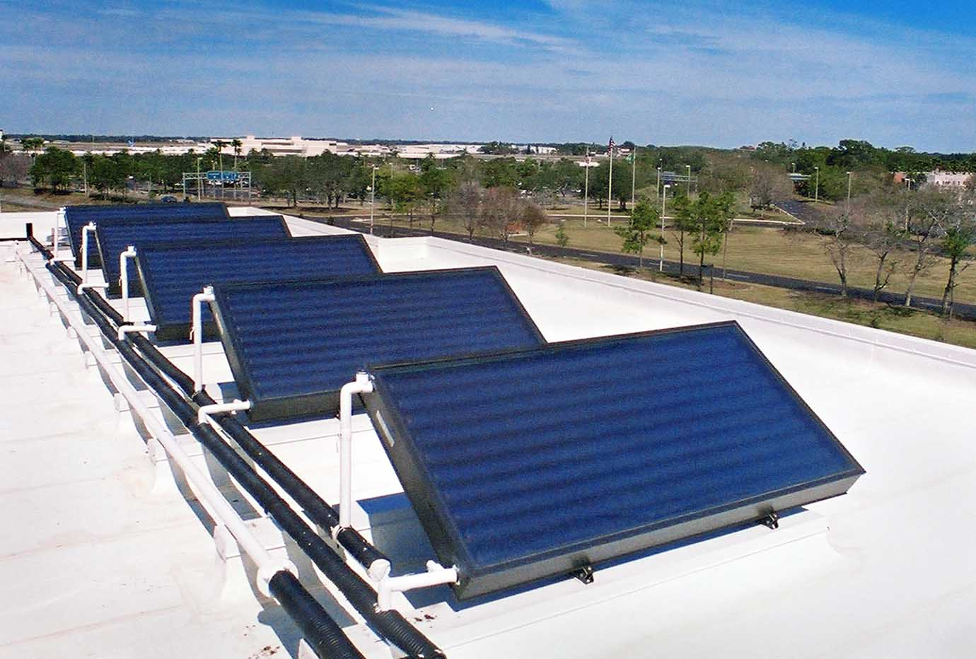
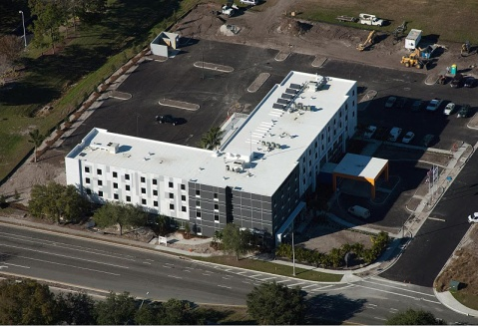
Hampton Inn Hotel
Solar Water Heater System
System Configuration
ProgressivTube® Passive Solar Water Heater
5 collectors, 50 gallon each
Complete system installation with 2 way plumbing
Tilted mounting on flat roof
Power Purchase Agreement (PPA) - Third Party Financing
Energy Monitoring (BTU, kWh, Gallons)
Project Location: Sarasota, Florida

Slide 8
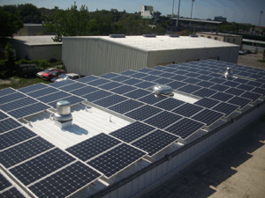
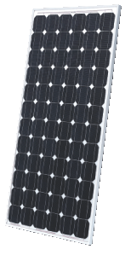
Community Coalition on Homelessness
Solar Electric System
This is a HUD Block Grant Project
48 kW Grid-Connected
Solar Electric System
Installation of solar photovoltaic panels, mounting hardware, electrical connections and 130kW standby generator.
Project Location: Bradenton, Florida

Slide 9
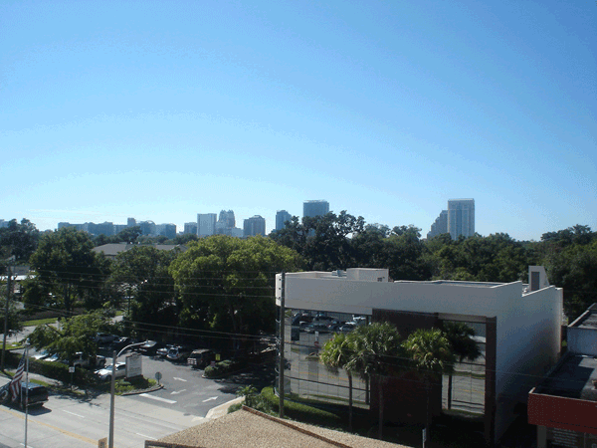
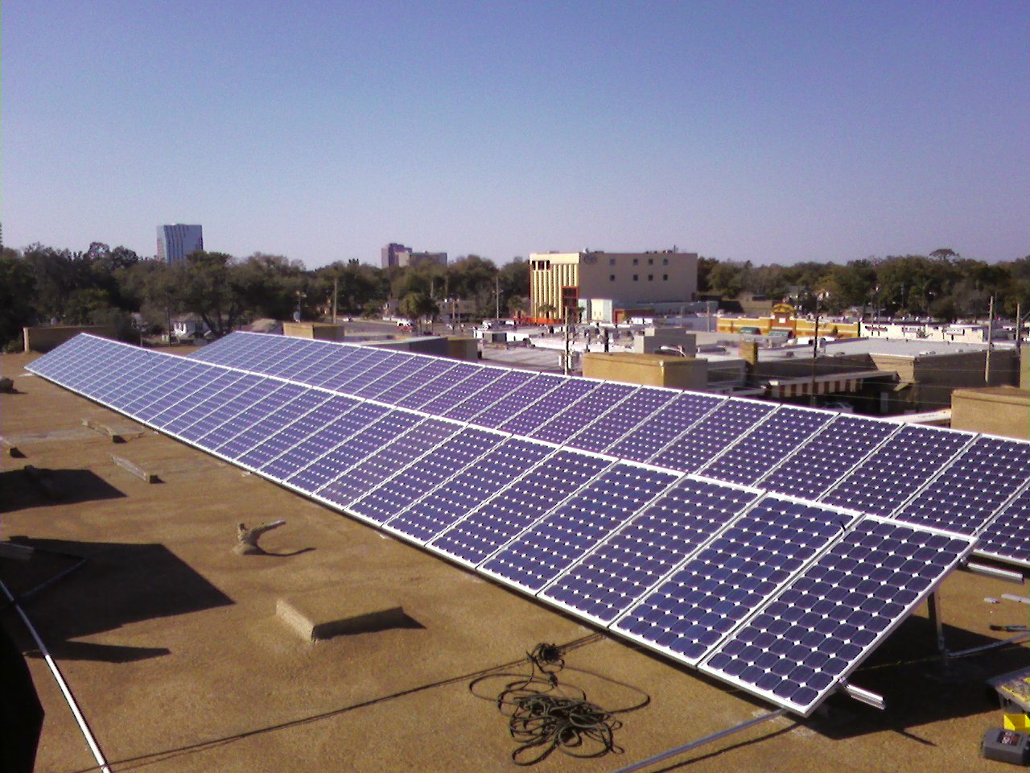
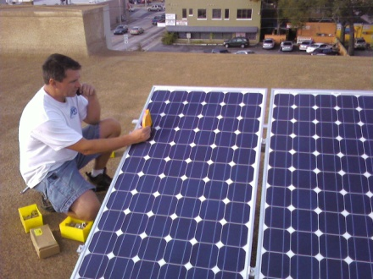
Harris Civil Engineers LLC
Solar Electric System
System Configuration
• Solar Electric System Grid-Connected • 60 Photovoltaic Modules
• 1 Sunny Boy 6000 Inverter
• 1 Sunny Boy 7000 Inverter
• Total size 10.5 kW
Project Location Orlando, Florida

Slide 10
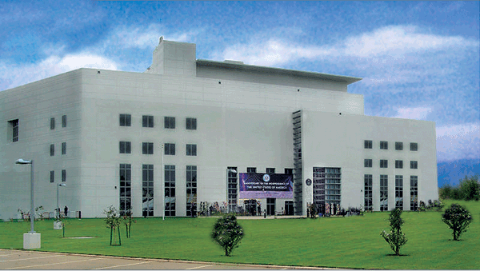
US Embassy – Nigeria
Solar Hot Water
System Configuration: • 20 ProgressivTube® ICS Units • One electric backup storage
tank system
• Collector footprint 640 sq ft
Project Location: Abuja, Federal Republic of Nigeria, Africa

Slide 11
Boys Scouts of America
Solar Hot Water
System Configuration: 224 sq ft of Flat Plate Solar Collectors – Active, Open Loop Project Location: Florida Keys

Slide 12
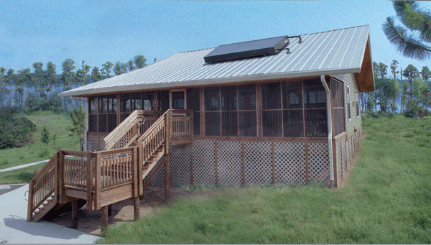
Lake Louisa State Park
Solar Hot Water
System Configuration: 20 ProgressivTube® Units – 40 gal. electrical backup tank Project Location: Clermont, Florida

Slide 13
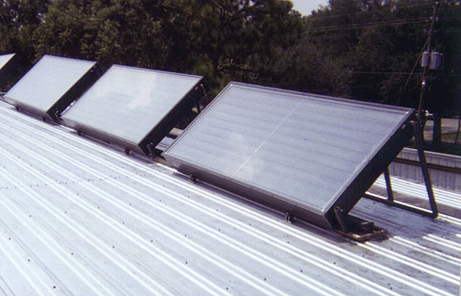
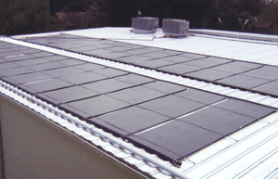
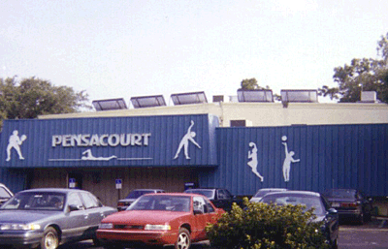
Pensacourt Fitness Club
Solar Hot Water – Solar Pool Heater
System Configuration: Solar Hot Water – 5 ProgressivTube® 50 gallon each Solar Pool Heater – 42 Vortex™ Solar Collectors Project Location: Pensacola, Florida

Slide 14
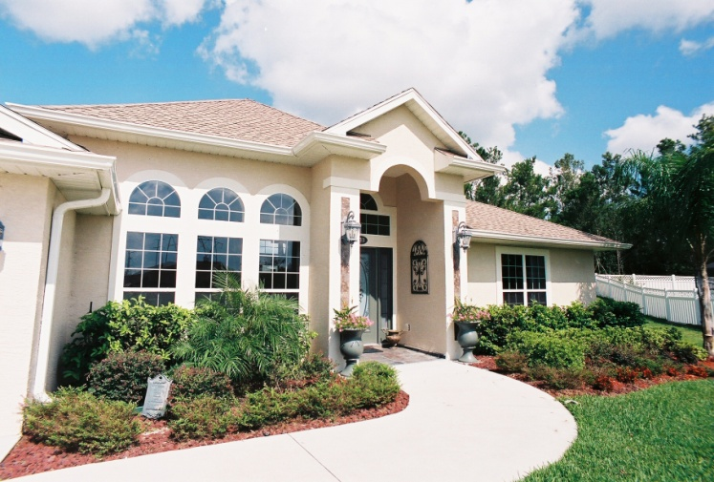
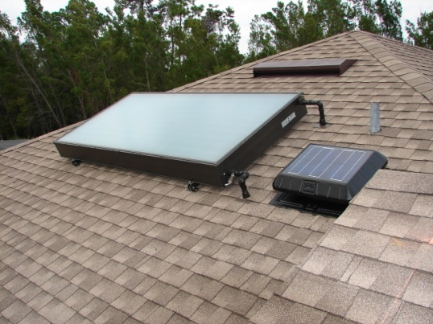
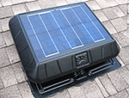
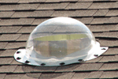
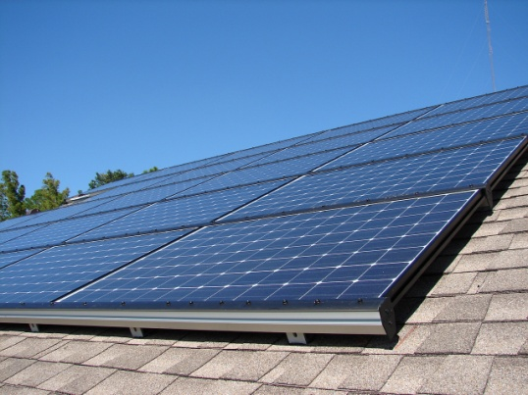
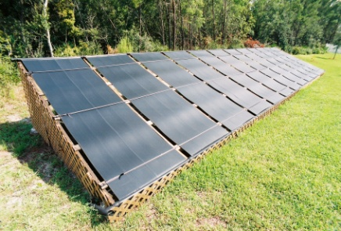
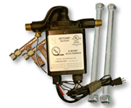
The Santiagos
Solar Home MakeOver – DeBary, Florida
Solar Electric
Solar Pool Heating
Solar Hot Water
Attic Ventilation: Solar Fan
Natural Lighting: Solar Skylights
Water Conservation: The Metlund

Slide 15
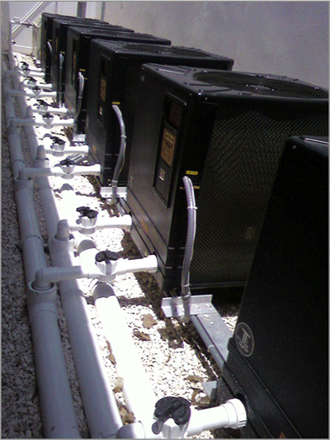
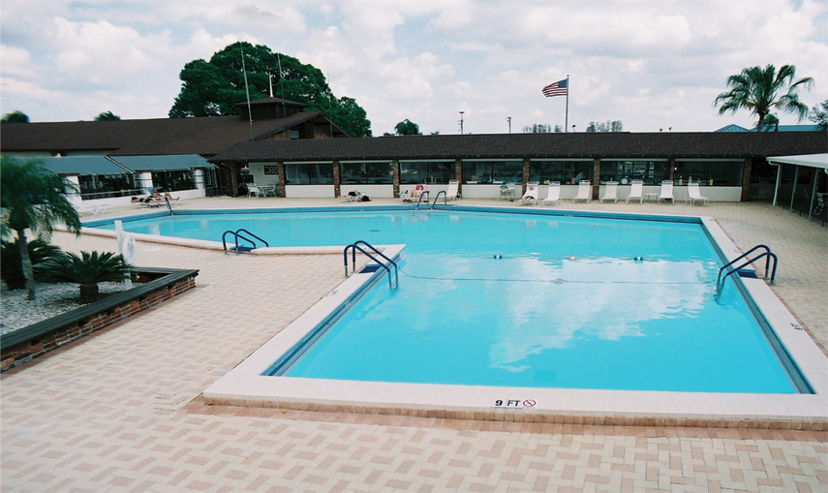
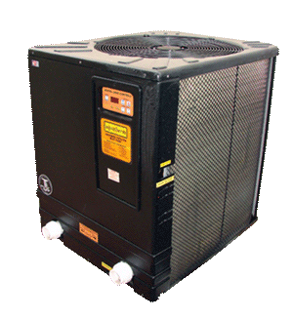
Sun City Center
Swimming Pool Heat Pump Pool Heating
System Configuration: 6 Aquatherm Electric
Heat Pumps
1 Gas Heater Backup
Project Location:
Sun City, Florida

Slide 16
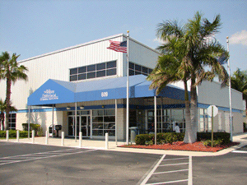
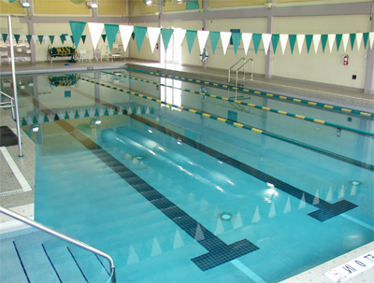
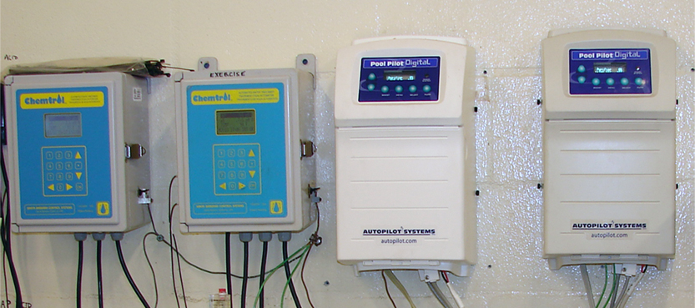
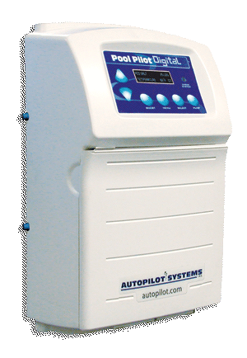
Lee Memorial Wellness Center
Pool Water Treatment
Automatic Pool Care
System Configuration: 2 Digital Pool Pilot Systems
& 2 Salt Conversion Cells
Project Location:
Cape Coral, Florida

